Slide 1
MACHINE LEARNING
AND ITS
TECHNIQUES

Slide 2
1.INTRODUCTION TO ML
OUTLINE :
2.SUPERVISED LEARNING
3.UNSUPERVISED LEARNING
4.GRAPHICAL MODEL
5.REINFORCEMENT LEARNING

Slide 3
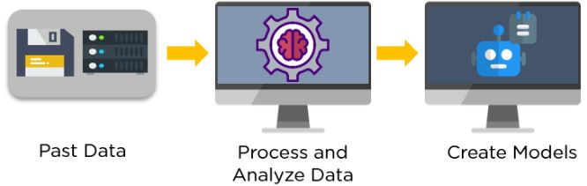
Machine Learning:
Machine Learning Enables a Machine to automatically learn from data, improve performance from experiences and predict things without being explicitly programmed
The Term Machine Learning was initially started by Aurthur Samuel in 1959.

Slide 4
When to use Machine Learning:
Human’s Expertise does not exist (Navigating On Mars).
Many human tasks (such as recognizing whether an email is spam or not spam).
You might be able to manually recognize a few hundred emails and decide whether they are spam or not. However, this task becomes tedious for millions of emails. ML solutions are effective at handling large-scale problems.
Models are based on huge amounts of data(Genomics).

Slide 5
Few examples of Machine Learning:
Recognizing Patterns:
1.Facial identifiers or facial expressions.
2.Hand written or spoken words.
Generating Patterns:
1.Generating images or motion sequences.
Recognizing Anomalies:
1.Unusual credit card transactions.
2.Unusual patterns of sensor readings in a nuclear plant.
Prediction:
(i). Web Search
(ii). E-Commerce
(iii).Space Exploitation
(iv). Robotics
(v). Social
(vi). Finance

Slide 6
Types of Machine Learning
Supervised Learning
Unsupervised Learning
Reinforcement Learning
Supervised Learning
Supervised Learning
Reinforcement Learning
Clustering
Classification
Regression
Decision Making

Slide 7
Some Algorithms of Machine Learning:
Classifications : Naive Bayes, Support Vector Classifications.
Regression : Linear Regression, Support Vector Regressions.
Clustering : K-means Clustering, Gaussian Mixture.
Decision Making : Q Learning , R Learning, TD Learning.

Slide 8

Supervised Learning:
We Provide Sample Labelled Data to the Machine Learning system in order to train it, and on that basis it provides the Output.
The Goal of Supervised Learning is to map the input data with the output data
Process of making predictions of the future based on past and present data.

Slide 9
Types Of Supervised Learning :
CLASSIFICATION: | REGRESSION:
1.Classification is the process of predicting the class of given data points.
1.How the typical value of the dependent variable changes when one or more indep var.
2.Classes are sometimes called as targets / labels or categories.
2.Regression will form a line,where in the line
is best suited on that situation”(Best fit Line)”
3.The main goal of classification is to identify the category/class to which anew data will fall under.
* Linear Classifier and
* Non Linear Classifier
3.Statistical Relationship among variables and to predict the “New Observant” .
* Linear Regression(Continuous Variable)
* Logistic Regression(Category Value)

Slide 10
Classifier:
An Algorithm that maps the input data to a specific category.
The Steps to be followed in the classification techniques:
Training by Input data
A Classification Model tries to draw some conclusion from the input values given for training.
It will predict the class labels/categories for the new data
The Algorithms Which are using in the classification :
Logistic Regression
K_Nearest Neighbor(KNN).
Naïve Bayes
Decision Tree
SVM(Support Vector Machine (classifier))
Random Forest

Slide 11
Naive Bayes:
Naïve Bayes Classifier is one of the simple and most effective Classification algorithms which helps in building the fast machine learning models that can make quick predictions.
It is a probabilistic classifier, which means it predicts on the basis of the probability of an object.
Some popular examples of Naïve Bayes Algorithm are spam filtration, Sentimental analysis, and classifying articles.
It is the most popular choice for text classification problems.

Slide 12
Working of Naive Bayes:
Convert the given dataset into frequency tables.
Generate Likelihood table by finding the probabilities of given features.
Now, use Bayes theorem to calculate the posterior probability.

Slide 13
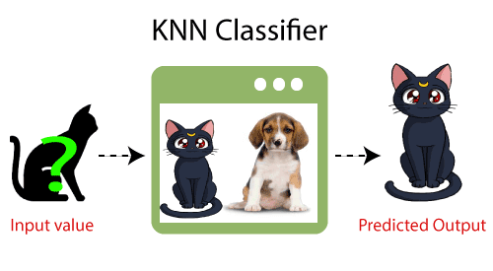
K-Nearest Neighbor(KNN) Algorithm:
K-Nearest Neighbour is one of the simplest Machine Learning algorithms based on Supervised Learning technique.
K-NN algorithm can be used for Regression as well as for Classification but mostly it is used for the Classification problems
K-NN algorithm assumes the similarity between the new case/data and available cases and put the new case into the category that is most similar to the available categories.

Slide 14
Steps to implement the K-NN algorithm:
Data Pre-processing step
Fitting the K-NN algorithm to the Training set
Predicting the test result
Test accuracy of the result(Creation of Confusion matrix)
Visualizing the test set result

Slide 15
Linear Regression:
Simple Linear Regression
Multiple Linear Regression
Polynomial Regression

Slide 16
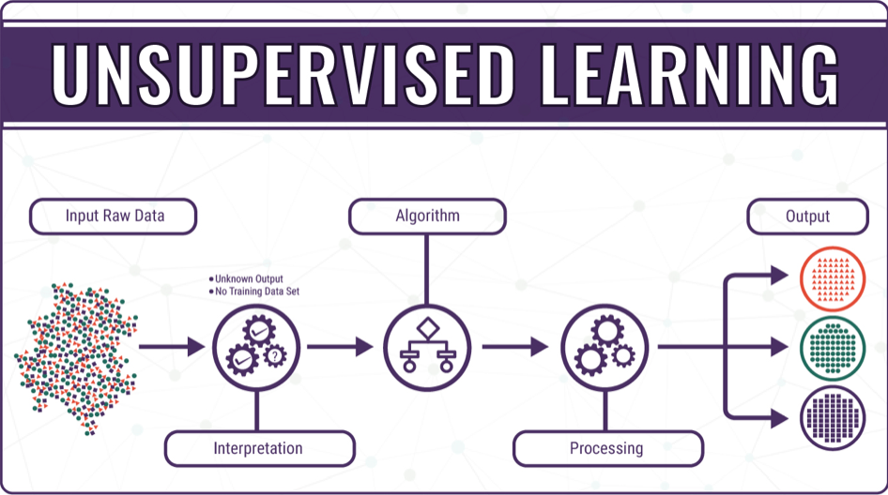
Unsupervised Learning:
What is unsupervised learning?
Unsupervised learning, also known as unsupervised machine learning, uses machine learning algorithms to analyze and cluster unlabeled datasets.
These algorithms discover hidden patterns or data groupings without the need for human intervention.

Slide 17
Why We are Using Unsupervised Learning:
Its ability to discover similarities and differences in information make it the ideal solution for exploratory data analysis, cross-selling strategies, customer segmentation, and image recognition.
Unsupervised learning models are utilized for three main tasks_clustering, association, and dimensionality reduction
Unlike supervised learning, unsupervised learning methods cannot be directly applied to a regression or a classification problem as one has no idea what the values for the output might be.

Slide 18
UnSupervised Algorithm
Clustering
K- Means Clustering
Dimensionality reduction.

Slide 19
CLUSTERING:
In machine learning too, we often group examples as a first step to understand a subject (data set) in a machine learning system.
Grouping unlabeled examples is called clustering. As the examples are unlabeled, clustering relies on unsupervised machine learning.
Types of Clustering:
Types of Clustering:
SOFT CLUSTERING
HARD CLUSTERING

Slide 20
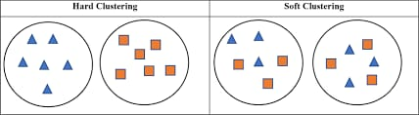
SOFT CLUSTERING
Soft clustering, the output provided is a probability likelihood of a data point belonging to each of the pre-defined numbers of clusters.
HARD CLUSTERING
In hard clustering, one data point can belong to one cluster only.

Slide 21
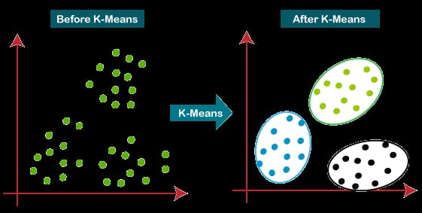
K-Means Clustering
K-means is a data clustering approach for unsupervised machine learning that can separate unlabeled data into a predetermined number of disjoint groups of equal variance – clusters – based on their similarities.
It's a popular algorithm thanks to its ease of use and speed on large datasets

Slide 22
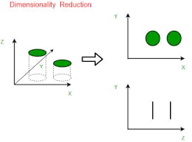
Dimensionality Reduction:
Dimensionality reduction is the task of reducing the number of features in a dataset. In machine learning tasks like regression or classification.
Dimensionality reduction is a machine learning (ML) or statistical technique of reducing the amount of random variables in a problem by obtaining a set of principal variables.

Slide 23
Probabilistic Graphical Modeling(PGM):
Probabilistic Graphical Models are rich frameworks for encoding probability distributions over complex domains.
These representations sit at the intersection of statistics and computer science, relying on concepts from probability theory, graph algorithms, machine learning, and more.
Why do we need PGM:
Compact Graphical Representation
Intuitive Diagrams of complex relationships
Convenient from computational aspects
Dynamic Solutions of Modelss

Slide 24
1.Compact Graphical Representation
PGM are frameworks used to create and represent compact graphical models of complex real world scenarios.
2. Intuitive Diagrams of Complex Relationships
PGMs give us intuitive diagrams of complex relationships between stochastic variables..
3.Convenient from Computational Aspect
PGMs are also convenient from computational point of view, since we already have algorithms for working with graphs and statistics.
4.Dynamic Simulation of Models Using PGM
We can simulate dynamics of industrial establishments, create models, and many other things.

Slide 25
Directed graph and Indirected Graph:
Directed Graph | Directed Graph
A type of graph that contains ordered pairs of vertices | A type of graph that contains unordered pairs of vertices
Edges represent the direction of vertexes | Edges do not represent the direction of vertexes
An arrow represents the edges | Undirected arcs represent the edges

Slide 26
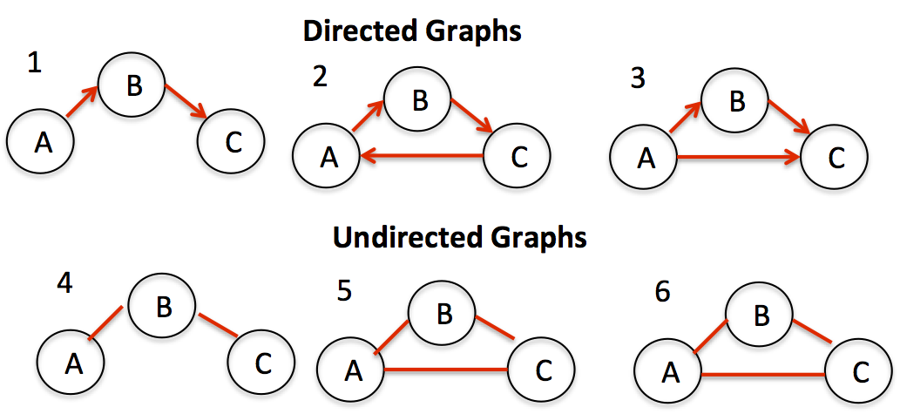
Sample diagram of Directed graph and Indirected Graph:

Slide 27
Directed graph and Indirected Graph:

Slide 29
thank you

